Slide 1
Threat Intelligence Support Unit (TISU)
TISU Review and Exam Prep Part I
Presented by:
@CroodSolutions
https://www.linkedin.com/in/manrod/
Created by:
Numerous contributors.

Slide 2
Agenda: TISU Exam Prep
Attacker Objectives.
General Attack and Defense Flows.
Lockheed Kill Chain.
Introduction to CTI, SOC, and IR.
A Look at MITRE Attack.
CIS18 (basics of defense).
Threats and Risk Management.
Summary of SOC and IR.

Slide 3
Attacker Objectives
First, we must understand, what they want to accomplish.

Slide 4
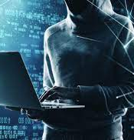
Different Objectives, for Different Adversaries
Nation-State
National secrets and IP.
Disruption and Distraction.
MDM (Disinfo).
Cybercrime
Ransomware and extortion.
Sale of stolen data.
Hacktivist
Data theft and Doxing.
DDoS.
Data destruction and sabotage.
Insider Threat
Revenge / grudge (see hacktivist).
Opportunist (see cybercrime)
Not exhaustive (this disclaimer applies to every slide).

Slide 5
Basics of Attack and Defense
The mechanics of a cyber attack can be relatively simple, at least when viewed at a high level to understand the general themes.

Slide 6

Two Types of Attacks (For Initial Foothold)
Attacks that involve a user.
Attacks that do not involve a user.
This Photo by Unknown Author is licensed under CC BY-SA-NC

Slide 7
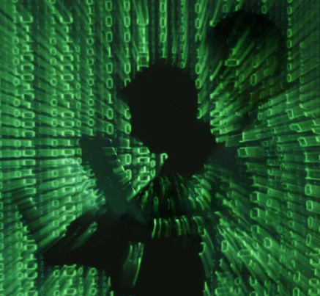
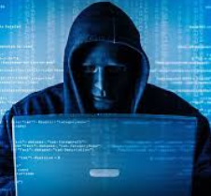
Typical Attack Flow
Email or Messaging
User Interaction
Web
Social Engineering
Initial
Attack Vector Selected
Application
No User Interaction
Server, Services or Cloud Infr.
Account or Identity

Slide 8
It All Starts w/ OSINT / RECON
Email
OSINT to research people
User Interaction
Web
Persons of Interest
Social Engineering
Something Happens
Application
Systems of Interest
OSINT of Infrastructure
No User Interaction
Identity
Server and Infrastructure

Slide 9

Initial Flow: Involves User Interaction
A
Link
Phishing
Was the link clicked?
See Account and Identity Flow (X)
Yes
Note that links can have malware and malware and attachments can have phishing links.
Malware on a host can also compromise credentials.
Attachment
Malware
Did it execute?
See endpoint malware flow (Y)
Yes
Something Happens
Watering Hole
Malvertising, reflected XSS, etc.
Depending on the outcome of the flow may lead to account compromise or host compromise, which is where the user/no-user interaction paths begin to converge.
Insider Threat
A

Slide 10
Initial Flow Examples: Attack Not Involving a User
Note that many cases involving a compromised host via malware delivered to a user workstation, for example, ultimately lead to the same place as an attack not involving a user.
Exploitation Method:
Frameworks and Tools (basic):
Exploit Application
OWASP 10, WAF, and AppSec
Move Laterally
Compromise Account
ATT&CK, ZTA,
and IAM
Gain Privileged Account
Attacker Achieves Objectives
X
A
A
Exploit Running Service
ATT&CK, ZTA, and Host Hardening
Expand
Reach
Y
Exploit Host OS CVE
ATT&CK, Patching and EDR

Slide 11
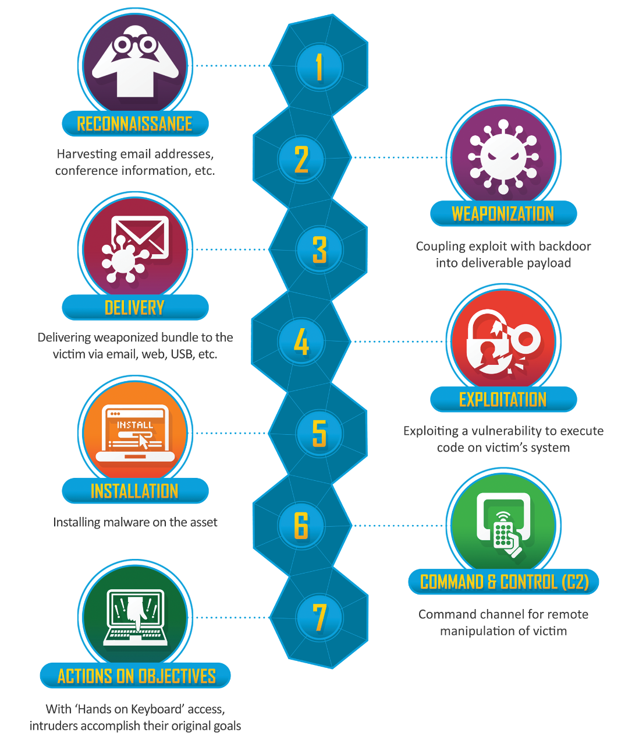
Cyber Kill Chain by Lockheed
https://www.lockheedmartin.com/en-us/capabilities/cyber/cyber-kill-chain.html

Slide 12

Do Not Trust, but Verify
Examples of some free testing tools:
Atomic Red Team
Sliver
AutoPwnKey and BypassIT
Metasploit
ZAP
Examples of some commercial tools:
Brute Ratel
Burp Suite
Cobalt Strike
Nessus
Ionix, RiskSense, Security Scorecard

Slide 13
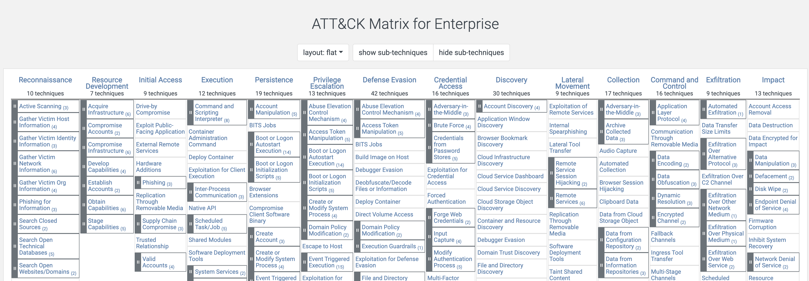
MITRE ATT&CK
https://attack.mitre.org/
Layers of intrusion; layers of opportunities for detection.

Slide 14
Cyber Threat Intelligence and Collective Defense (CTI)

Slide 15
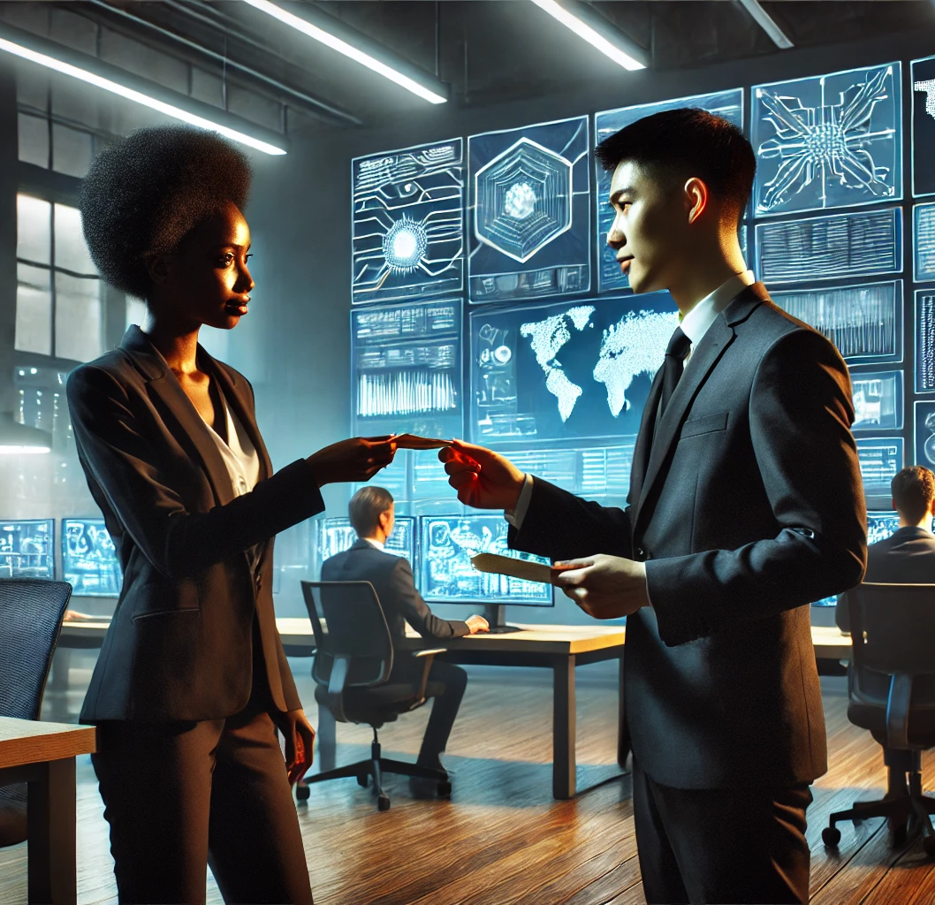
Why do we need to share information and work together?
Adversaries share information.
Defense is difficult, in particular, if you do it alone.
Collaborate, share, and elevate the entire community.

Slide 16
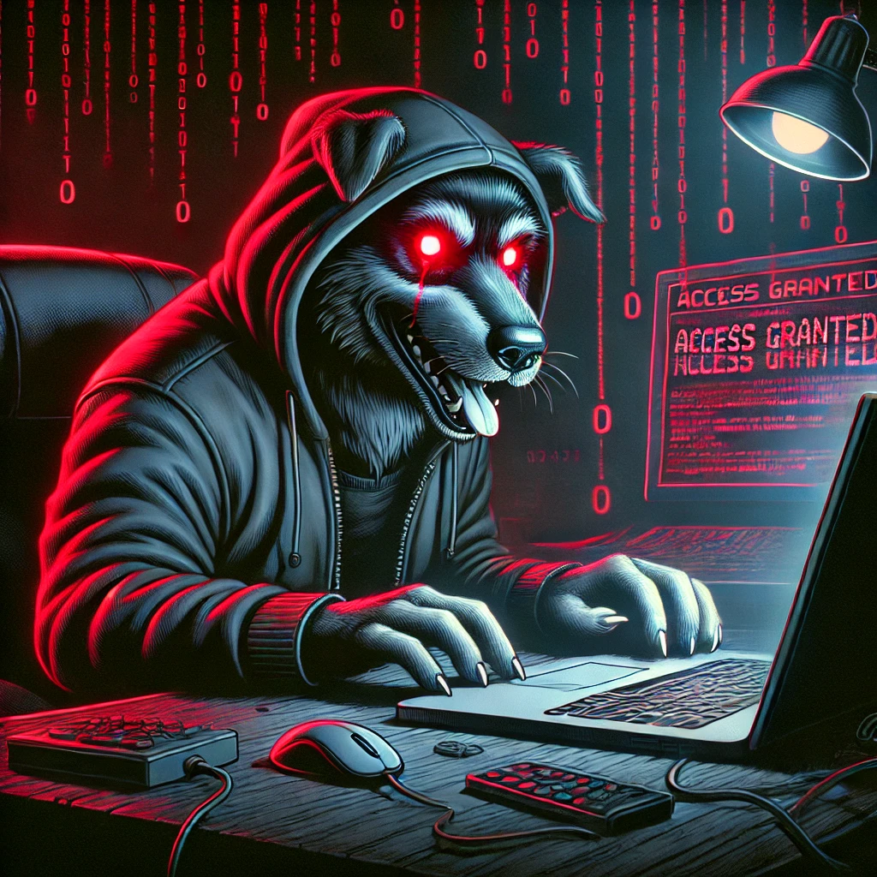
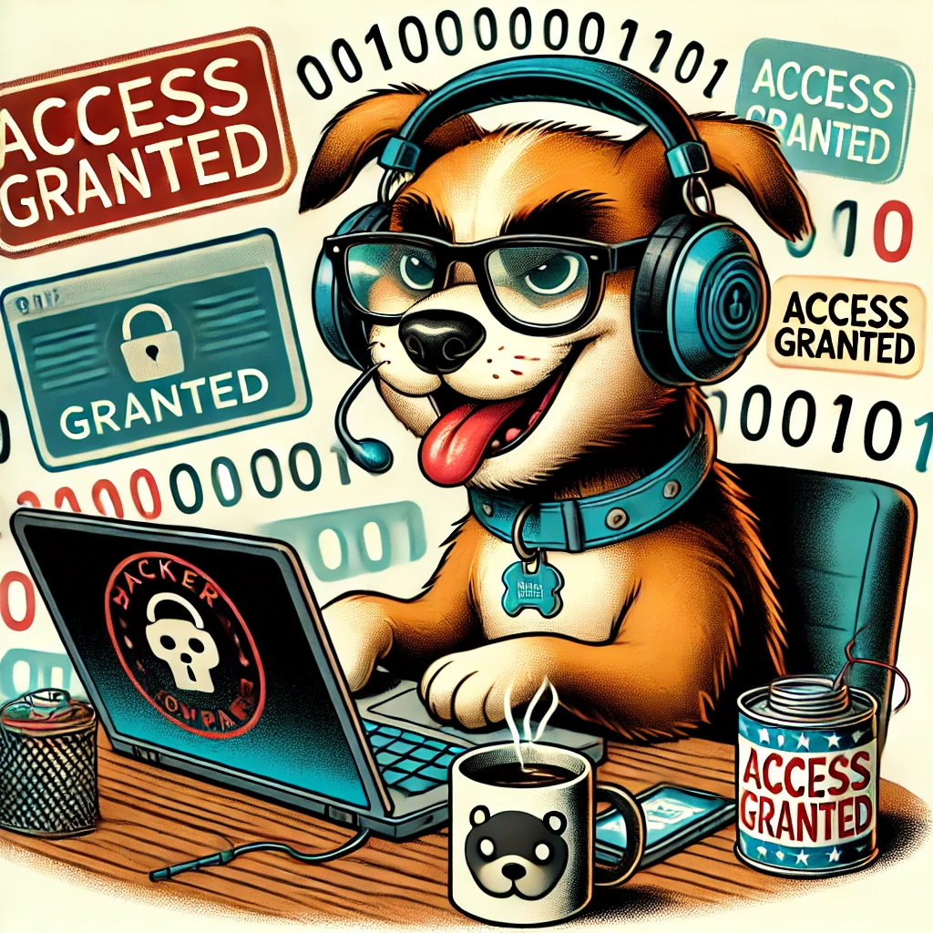

True or False?
Adversaries only need to get it right once, while defenders have to get it right every time.

Slide 17
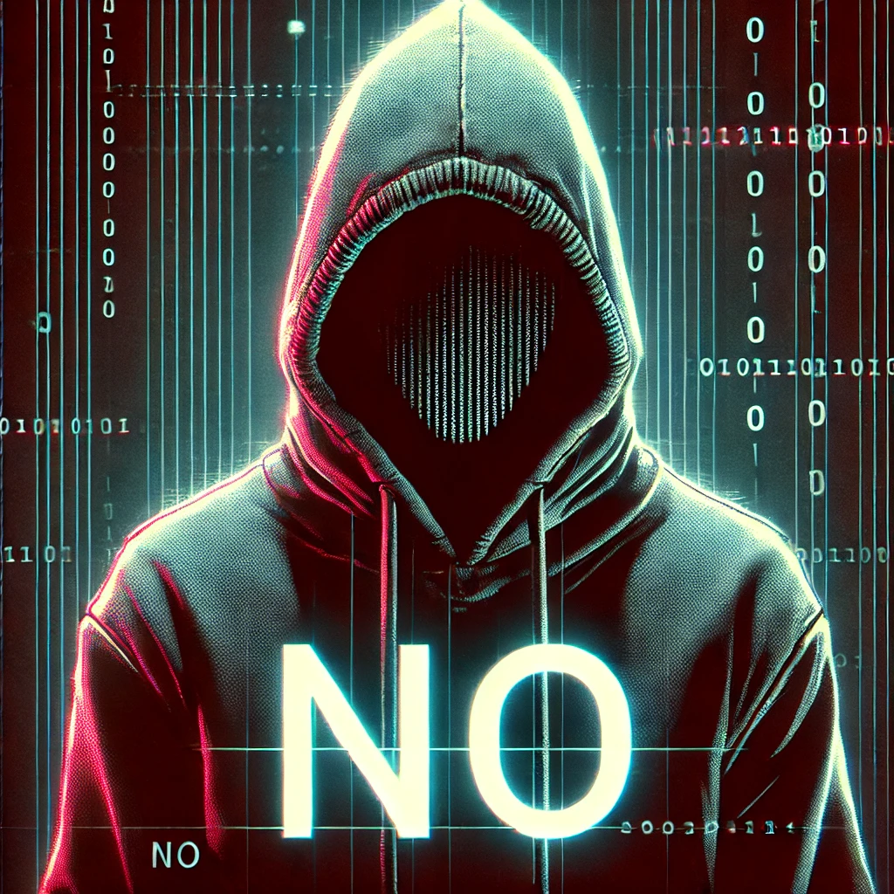
False!!!!
The entire point of a kill chain / MITRE ATT&CK is to map out a flow, with control points and tollgates where an attack CAN be disrupted.
Know the flows.

Slide 18

How does this relate to collective defense?
As adversaries develop new tactics for intrusion, defense evasion, and lateral movement we raise attackers' cost and reduce their effectiveness when we share information.

Slide 19

Types of information sharing
Specific IOCs/IOAs (the what)
IPs/Domains/File Hashes
Rules or Signatures (Sigma, Yara, Suricata)
Strategic and Tactical: TTPs
What adversaries are doing and how.
Objectives and approaches
Specific tactics (layering in the how)

Slide 20

A Web of Communities
Arizona Technology Counsel.
ACTRA: Arizona Cyber Threat Response Alliance.
TISU: Threat Intelligence Support Unit.
InfraGard.
ISAC/ISOWs
Vendor-Augmented Information Sharing.

Slide 21

People, Processes, and Technology
Collective Defense comes alive, when we fuse information sharing with cultivation of talent and knowledge pipelines, creating a defensive web.
Like an immune system, these elements come together to react to threats as a broader system.
For example, any of us individually may fail to varying degrees, at repelling a given attack, while the overall ecosystem succeeds at stopping widespread impact.
Even when we fail, recovery is easier when we are not doing it alone.
Technology
Process
People

Slide 22
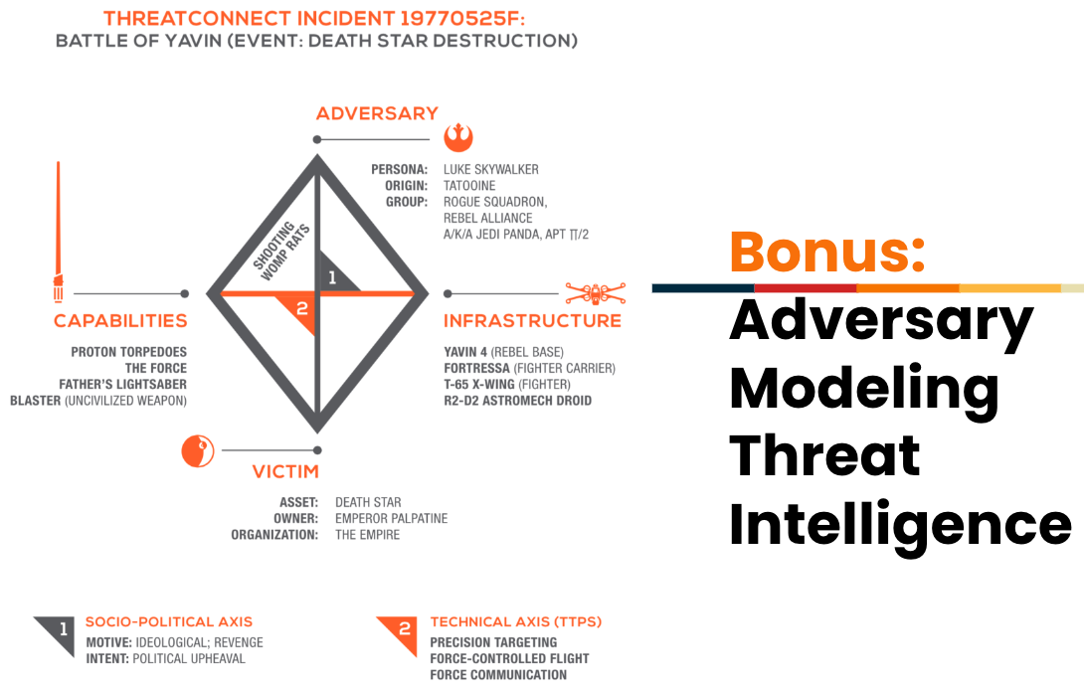
Credit: Threat Connect

Slide 23

Safe Sharing of Intelligence
There are several options that allow you to safely share malicious links:
Screen shot
Defang the link hxxps://www.google[dot]com
It is not unsafe to have the text of malicious IP addresses, so just providing them as they are is fine.
For malware, if sharing live samples, place in a password protected zip with the password of “infected” or “malware”
This Photo by Unknown Author is licensed under CC BY-SA-NC

Slide 24

TLP: Red Amber + Strict Amber Green Clear
Traffic Light Protocol
This Photo by Unknown Author is licensed under CC BY-SA

Slide 25
MITRE ATT&CK

Slide 26
MITRE ATT&CK
https://attack.mitre.org/
MITRE ATT&CK provides a very robust view of how attacks work, which also helps you to properly defend.

Slide 27
RECON

Slide 28
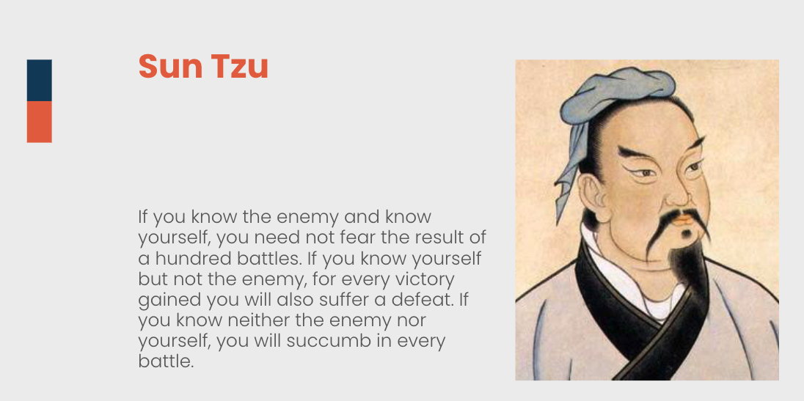
Recon: What does it mean and why does it matter?
Short for Reconnaissance
Is a military term to scope out and understand the battlespace.
Essential for mounting an effective attack (or defense)
Adversaries and penetration testers will want to understand the infrastructure you have, the services you use, methods you use to protect and present them.

Slide 29

Know Yourself
We have to understand our own environment if we wish for any chance of defending it.
You need to understand what you have that adversaries will want to compromise. You need to understand what infrastructure you run, services, you use and how you protect and present them.

Slide 30
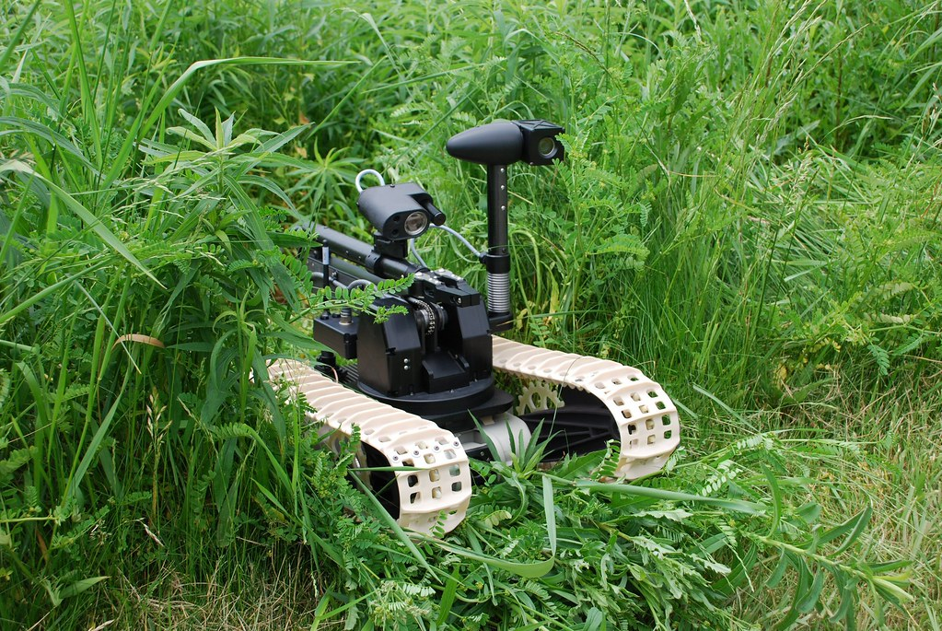
Recon can include:
Scanning
Searching
Phishing
Poaching
Active Scanning
Scanning IP ranges.
Scanning for vulnerabilities
Scanning for wordlists (fingerprinting)
Phishing for Information
Send malicious email messages with the intent to gain information or to gain access to find information to plan an attack.
Passive searching
Search open websites or domains.
Social Media, Search Engines, Code Repositories (e.g., GitHub).
Search open technical databases:
DNS, WHOIS, scan databases, etc.
Poaching
Searching for Closed Sources
Includes purchase information or access (e.g., LAPSUS$)
This Photo by Unknown Author is licensed under CC BY-NC-ND

Slide 31

Examples of some recon tools:
Google or LLM
dig
curl
nslookup
Recon-ng
Maltego
Spiderfoot

Slide 32
Resource Development

Slide 33

Resource Development
Basic precondition for launching an attack:
Cultivate infrastructure needed for attacks (free, vs. paid, vs. stollen).
Acquire accounts to use in attacks, either via compromising them or cultivating them by signing up/creating fake profiles, or via bot activity.
Micro-Iterations of MITRE ATT&CK:
Often the resource development phase, includes its own kill chain, following most of the stages to compromise and accumulate resources.
Build versus buy – sometimes resources cultivated by one actor are used by a different adversary.

Slide 34
Initial Access

Slide 35

A Simplified Look at Initial Access
What is the goal of this phase?
Gain initial access / a foothold into the environment, from which they can expand.
What are the basic high-level categories?
Common:
Attacking internet facing systems, services, and accounts.
Attacking users via phishing or malware.
Social engineering.
Purchasing of valid accounts or access.
Also can include:
Supply chain compromise.
Replication via removable media to reach air-gapped systems.
Insider threat / trusted relationship.
Hardware compromise / hardware additions
This Photo by Unknown Author is licensed under CC BY-NC-ND

Slide 36

A few common scenarios (user)
User clicks a link
(phishing or malware)
User opens an attachment
(malware or obscured link)
User visits a web site that is serving up malware
(drive by download or malvertising)
User clicks a link and approves access to malicious app
(OAuth Phishing)
This Photo by Unknown Author is licensed under CC BY-NC-ND

Slide 37

A few common scenarios (not-user)
Attack a web application
(see OWASP)
Attack a running service or OS flaw
(see Nessus, Metasploit, etc.)
Authenticate to an exposed account
(buy credentials, default creds, brute force, etc.)
This Photo by Unknown Author is licensed under CC BY-SA

Slide 38


Social Engineering
Convince user to take an action
MFA push or bypass
Gain access to a secure facility under a pretext
This Photo by Unknown Author is licensed under CC BY-NC-ND

Slide 39
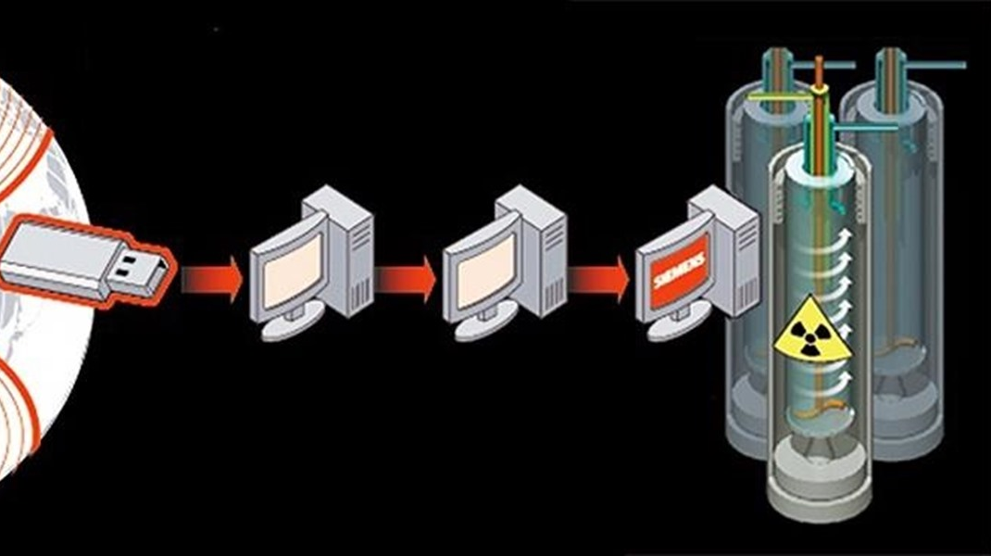
A few other ways to consider
Supply-Chain
(hardware or software)
Complex hybrid combinations
(e.g., phishing + MFA push, etc.)
Playbooks to compromise OT/air gapped networks
Complex malware intended to cross the gap (Stuxnet)
USB or peripheral hardware poisoning (see both Supply-Chain and Social Engineering)
This Photo by Unknown Author is licensed under CC BY-NC-ND

Slide 40
Execution

Slide 41
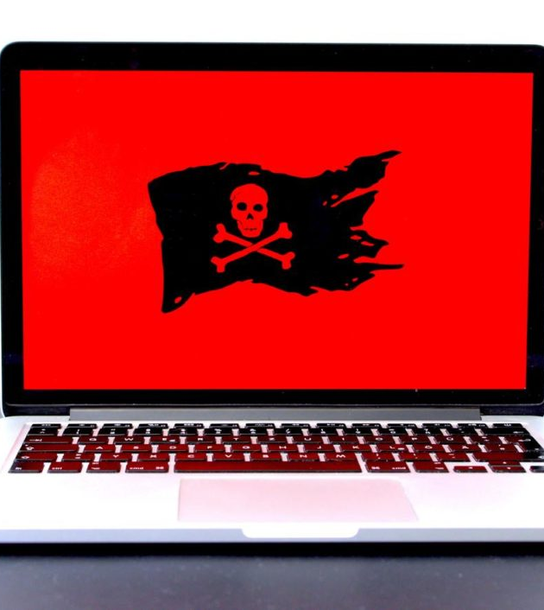
Execution
What is Execution phase:
This is where the attacker gets their code to run on a target system.
Sometimes things will flow from Initial Access to Execution fairly seamlessly and other times there is distinct delineation between these steps.
A variety of methods can be utilized:
T1059 via scripting is very common (PowerShell, CMD, VB, Python, JS, etc.)
T1024 via User Execution is also very common (user clicks, opens, runs, etc.)
Other methods in this category include WMI, abuse of system services, serverless execution, malicious container deployment – the list goes on.
This Photo by Unknown Author is licensed under CC BY-SA-NC

Slide 42
Persistence

Slide 43

Establishing Persistence
Attackers want to develop that staying power.
After all, they worked hard to gain access to that system (maybe). They do not want to lose it the moment the system reboots or a password gets reset.
The name of the game for the adversary is to have a persistent foothold that will let them come back, whenever they have the inclination.
This Photo by Unknown Author is licensed under CC BY-SA

Slide 44
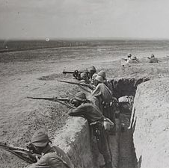
Examples of Methods for Establishing Persistence
Create or manipulate an account.
Scheduled task or job.
Scripts or programs to run at boot or logon.
Browser extensions.
Modify authentication processes or flows.
Implant cloud container with malicious code/functionality.
This Photo by Unknown Author is licensed under CC BY-SA

Slide 45
Privilege Escalation

Slide 46


Escalating Privileges
Attackers have high, high hopes for their exploits.
The initial account a compromised user, service, or application is running under typically does not provide all of the capabilities an attacker needs to accomplish their goals (or even their next steps).
It is important to note that there is some overlap between:
Establishing Persistence and Escalating Privileges.
Escalating Privileges and Lateral Movement.
Sometimes a single step will escalate privileges and make an attacker persistent or will set them up to move laterally.

Slide 47

Examples of some Privilege Escalation techniques:
Specific CVEs for OS or installed software that allow for privilege escalation.
UAC bypass.
Elevating execution with a user prompt.
Token impersonation or theft.
Parent PID spoofing / injection.
Escape to host.
This Photo by Unknown Author is licensed under CC BY

Slide 48
Defense Evasion

Slide 49
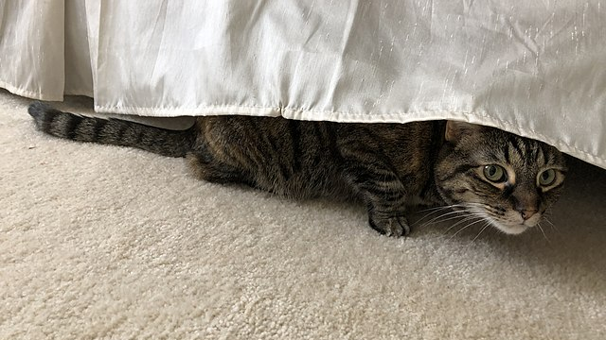
Defense Evasion
Rooms full of people like us, work hard to make it difficult to compromise systems and environments to carry out attacker objectives such as Ransomware delivery / Double Extortion.
Since mature organizations have a wide range of security controls, along with evolving and adaptive response capabilities, attackers are also working hard to find ways to achieve their objectives unimpeded and without detection.
Defense Evasion is the art and science of finding ways around controls and detective mechanisms. This topic goes deep, so we will just scratch the surface.
This Photo by Unknown Author is licensed under CC BY-SA

Slide 50
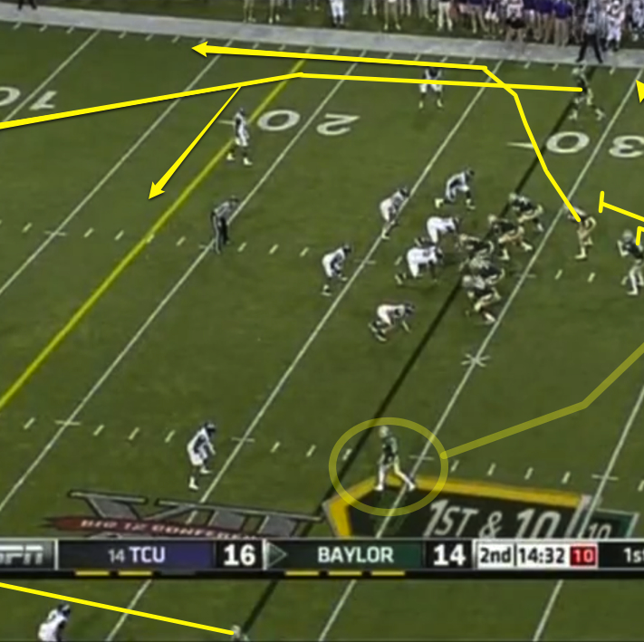
A few examples of Defense Evasion include:
Exploitation for defense evasion/disable tools.
GPO modification.
Indicator removal.
Masquerading (make malicious things look ok).
Use default/local accounts, service accounts, or other powerful native capability.
Pass the hash (could also be lateral movement).
This Photo by Unknown Author is licensed under CC BY-NC-ND

Slide 51
Overall Flow: Discovery, Credential Access and Lateral Movement

Slide 52

Overall Flow
Lateral Movement
Discovery
Credential Access

Slide 53
Credential Access

Slide 54
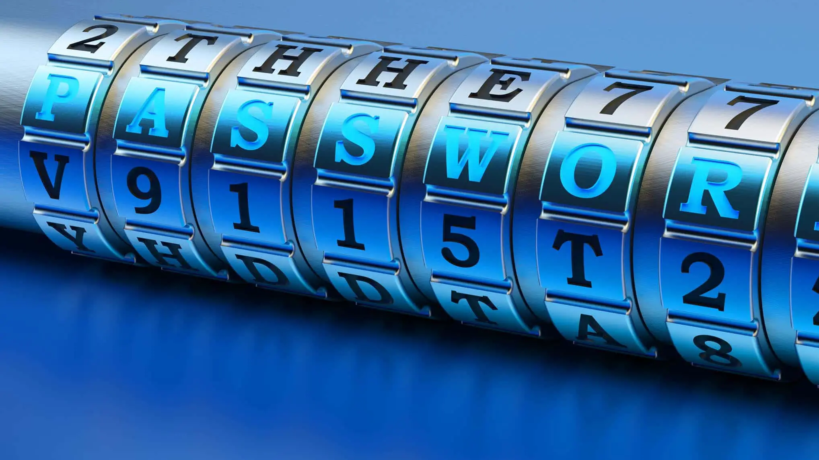
Why does the attacker care about credential access, if they have already compromised a system?
Credentials are key to expanding reach in an environment:
Fully compromising a system usually has limited intrinsic value.
Usually, the system used for initial access does not have the capabilities for the attacker to accomplish their objectives.
Having to re-exploit each system they need to control, individually would become tedious and noisy (increasing odds of getting stopped).
Instead, the goal is to have the ability to use or impersonate powerful accounts, to carry out objectives using administrative capabilities innate to the target environment.
This Photo by Unknown Author is licensed under CC BY-NC-ND

Slide 55

What is Credential Access?
It is hijacking the ability to effectively use accounts that do not belong to the attacker, via a variety of methods.
On a more practical level, it comes down to enumerating and discovering accounts, followed by compromising those needed to succeed (in the attack).
It can flow in the opposite direction as well – compromise what you can and see what you happen to have.

Slide 56

A Few Key Techniques
Adversary-in-the-Middle
Brute Force
OS Credential Dumping
Obtain Credentials from Password Stores
Cracking hashes / brute forcing offline vaults.
Input Capture
Session Hijacking
Locate Unsecured Credentials
This Photo by Unknown Author is licensed under CC BY-NC

Slide 57
Discovery

Slide 58

What is the goal of discovery?
Understanding the environment, to plan next steps
I like to say that every attack is an insider attack, once the discovery phase has been completed (they know your environment like it is their own home).
Map out the environment to see what type of opportunities are available.
Discovery of accounts, domain trusts and GPOs.
Discovery of networks and traffic.
Discovery of systems, installed software and possible vulnerabilities.
This Photo by Unknown Author is licensed under CC BY-SA

Slide 59
Lateral Movement

Slide 60
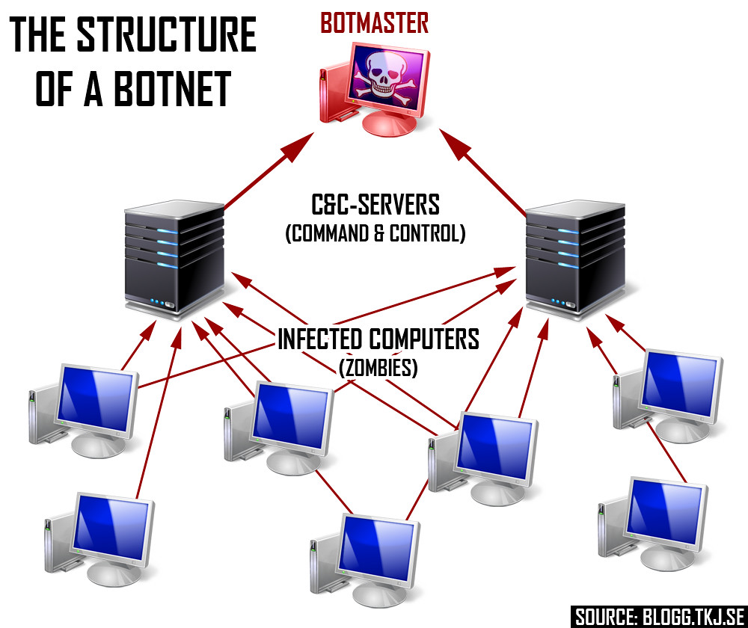
What is Lateral Movement?
As we have discussed previously, the system(s), account(s) or resource(s) an attacker lands on first / early on, in most cases does not allow them to fully accomplish their objectives.
One important thing to remember is that lateral movement involves more than just the scenario of malware moving from one host to another. While in some cases, this represents the complete picture, more often it involves credentials, services, and/or tools that give them a great deal of influence within an environment.

Slide 61

Examples of Lateral Movement Techniques
Exploitation of remote services or APIs.
Internal spear phishing or social engineering using important users/accounts.
Pass the hash/pass the ticket
Authenticate using sniffed or compromised credentials.
Circle back to execution phase, but on a new host now.
This Photo by Unknown Author is licensed under CC BY

Slide 62
Collection

Slide 63

Collection
What is Collection?
This is the process of collecting data, sometimes staging it for later exfiltration.
Collection goes through micro-iterations, in addition to the macro-level.
Some Examples:
Collect data from the local host(s) compromised.
Pull data from an exploited application.
Data from information repositories (e.g., file shares, code repositories).
Extract data from cloud storage.
Adversary in the Middle (covered during credential access).
Input capture (e.g., keylogging, web page capture).
BEC: Business Email Compromise (e.g., mail or contact dumping).

Slide 64
Command and Control

Slide 65

Command and Control
What is C2?
C2 is how an adversary gives instructions to, receives data from, and controls the actions of compromised hosts.
Often this includes the use of covert communication methods to make the C2 traffic look like regular/expected network traffic in an environment.
Some Examples:
Remote Access Software (e.g., Log Me In, Team Viewer).
Web sites including social medial and cloud storage can stage instructions, tools and secondary payloads.
Use of bot nets, sometimes including large distributed networks of compromised systems.
Using proxying, protocol tunneling, and the use of non-standard ports to disguise communication with compromised assets.

Slide 66
Exfiltration

Slide 67

Data Exfiltration
What is Exfiltration?
Removing data from an environment, ideally (from the attacker perspective), without detection.
This often involves covertly staging, packaging, and transferring data.
Some examples:
See C2… often exfiltration takes place via the Command and Control communication pathway.
Cloud storage or other online resources that support file upload.
Techniques to conceal data egress may include breaking it into chunks, encrypting the data, transmitting over expected protocols or uploading to attacker-controlled accounts, with legit and expected cloud services.

Slide 68
Impact

Slide 69

By this phase it is a little late… get ready for a rough ride.

Slide 70
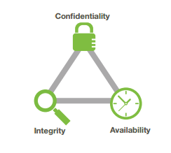
What is impacted?
This Photo by Unknown Author is licensed under CC BY-NC

Slide 71

Some possible impact scenarios:
Data Encrypted for Ransom.
Disk wipe, boot record destruction, and/or encrypted for destruction.
Deny use of important accounts or resources.
Data manipulation.
Defacement.
DDoS.
This Photo by Unknown Author is licensed under CC BY-NC

Slide 72
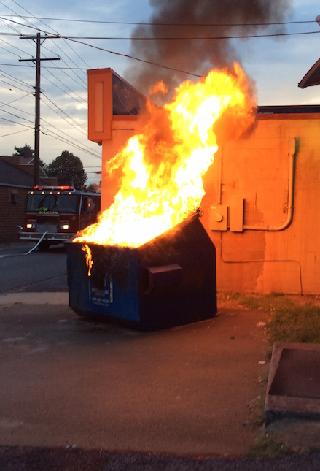
What Happens Post-Impact?
Three key plans come together:
Incident Response Plan.
Disaster Recovery Plan.
Business Continuity Plan.
This Photo by Unknown Author is licensed under CC BY-NC

Slide 73
CIS 18

Slide 74
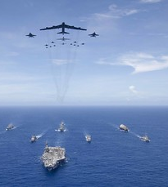
What is the CIS 18?
What is it?
A list of critical controls that you can implement, as a roadmap to having a good security program.
History
Formerly known as the SANS Top 20
This project took on a life of its own and evolved into CIS Critical Security Controls.
CIS / the Center of Internet Security is the nonprofit organization that maintains and evolves the CIS 18.
Why are there 18 now?
CIS v8 reorganized them by the types of activities, as opposed to who does them.
This reorganization combined with a decreased emphasis/relative importance of physical controls, collapsed them down from 20 to 18 control categories.

Slide 75

How to use the CIS 18
Where it is useful:
It is a great high-level checklist, to understand the elements of an effective security program.
It includes some supporting detail and an assessment tool, but there are gaps IMHO, once you get down into the detail.
Limitations:
Frameworks like this evolve slowly and require lots of deliberation, so newer technologies may be pretty critical before they get rolled in.

Slide 76
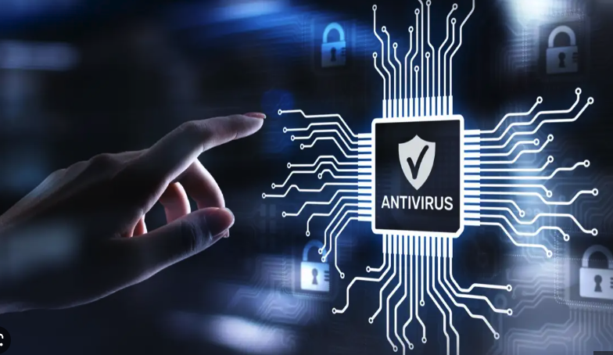
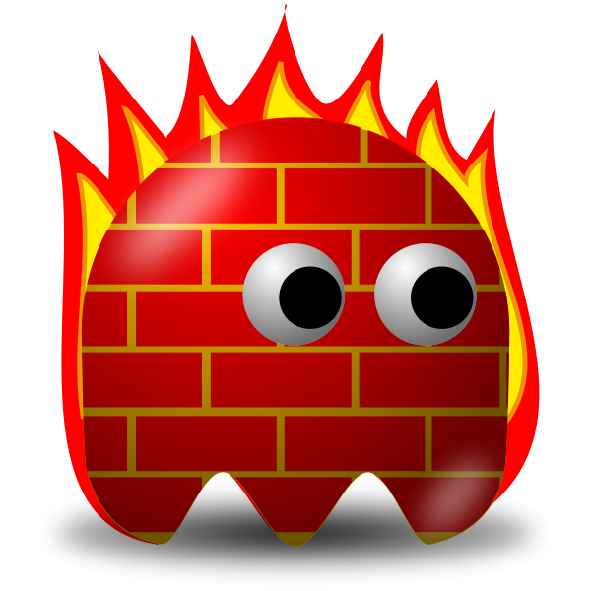
What are the 18 Controls (at a glance)?
CIS Control 1: Inventory and Control of Enterprise Assets
CIS Control 2: Inventory and Control of Software Assets
CIS Control 3: Data Protection
CIS Control 4: Secure Configuration of Enterprise Assets and Software
CIS Control 5: Account Management
CIS Control 6: Access Control Management
CIS Control 7: Continuous Vulnerability Management
CIS Control 8: Audit Log Management
CIS Control 9: Email and Web Browser Protections
CIS Control 10: Malware Defenses
CIS Control 11: Data Recovery
CIS Control 12: Network Infrastructure Management
CIS Control 13: Network Monitoring and Defense
CIS Control 14: Security Awareness and Skills Training
CIS Control 15: Service Provider Management
CIS Control 16: Application Software Security
CIS Control 17: Incident Response Management
CIS Control 18: Penetration Testing

Slide 77
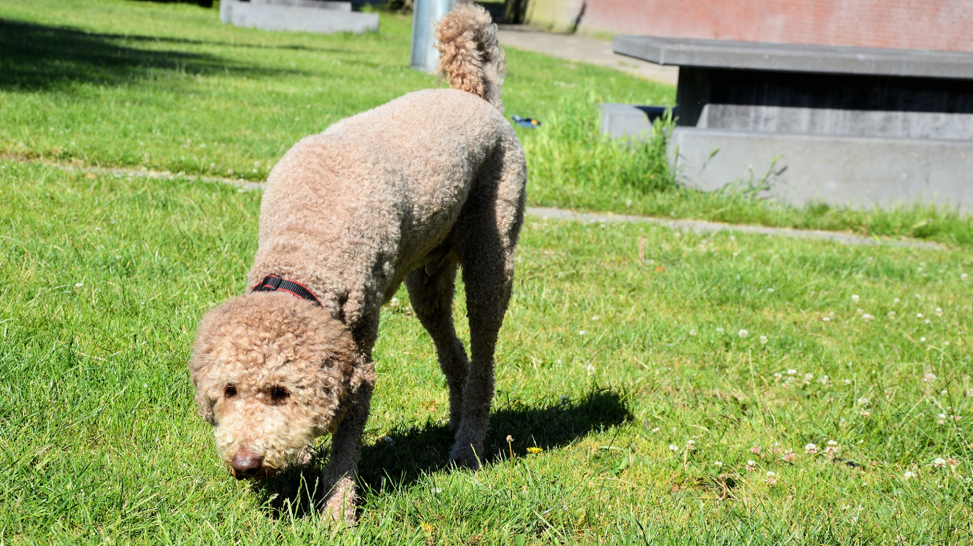
Finding and Protecting Assets
CIS Control 1: Inventory and Control of Enterprise Assets
Tracking and managing your workstations, servers, mobile devices, and all other connected devices (can also include cloud, IOT, SCADA, etc.)
CIS Control 2: Inventory and Control of Software Assets
Finding and managing the lifecycle of software products.
These can range from desktop software running on user workstations to large enterprise solutions that are critical to service delivery.
Also very intertwined with Application Software Security (16).
CIS Control 4: Secure Configuration of Enterprise Assets and Software
Once you know where systems and enterprise software are all located, it is time to lock it down and protect it.
Very closely related Application Software Security (16) and Continuous Vulnerability Management (7).

Slide 78
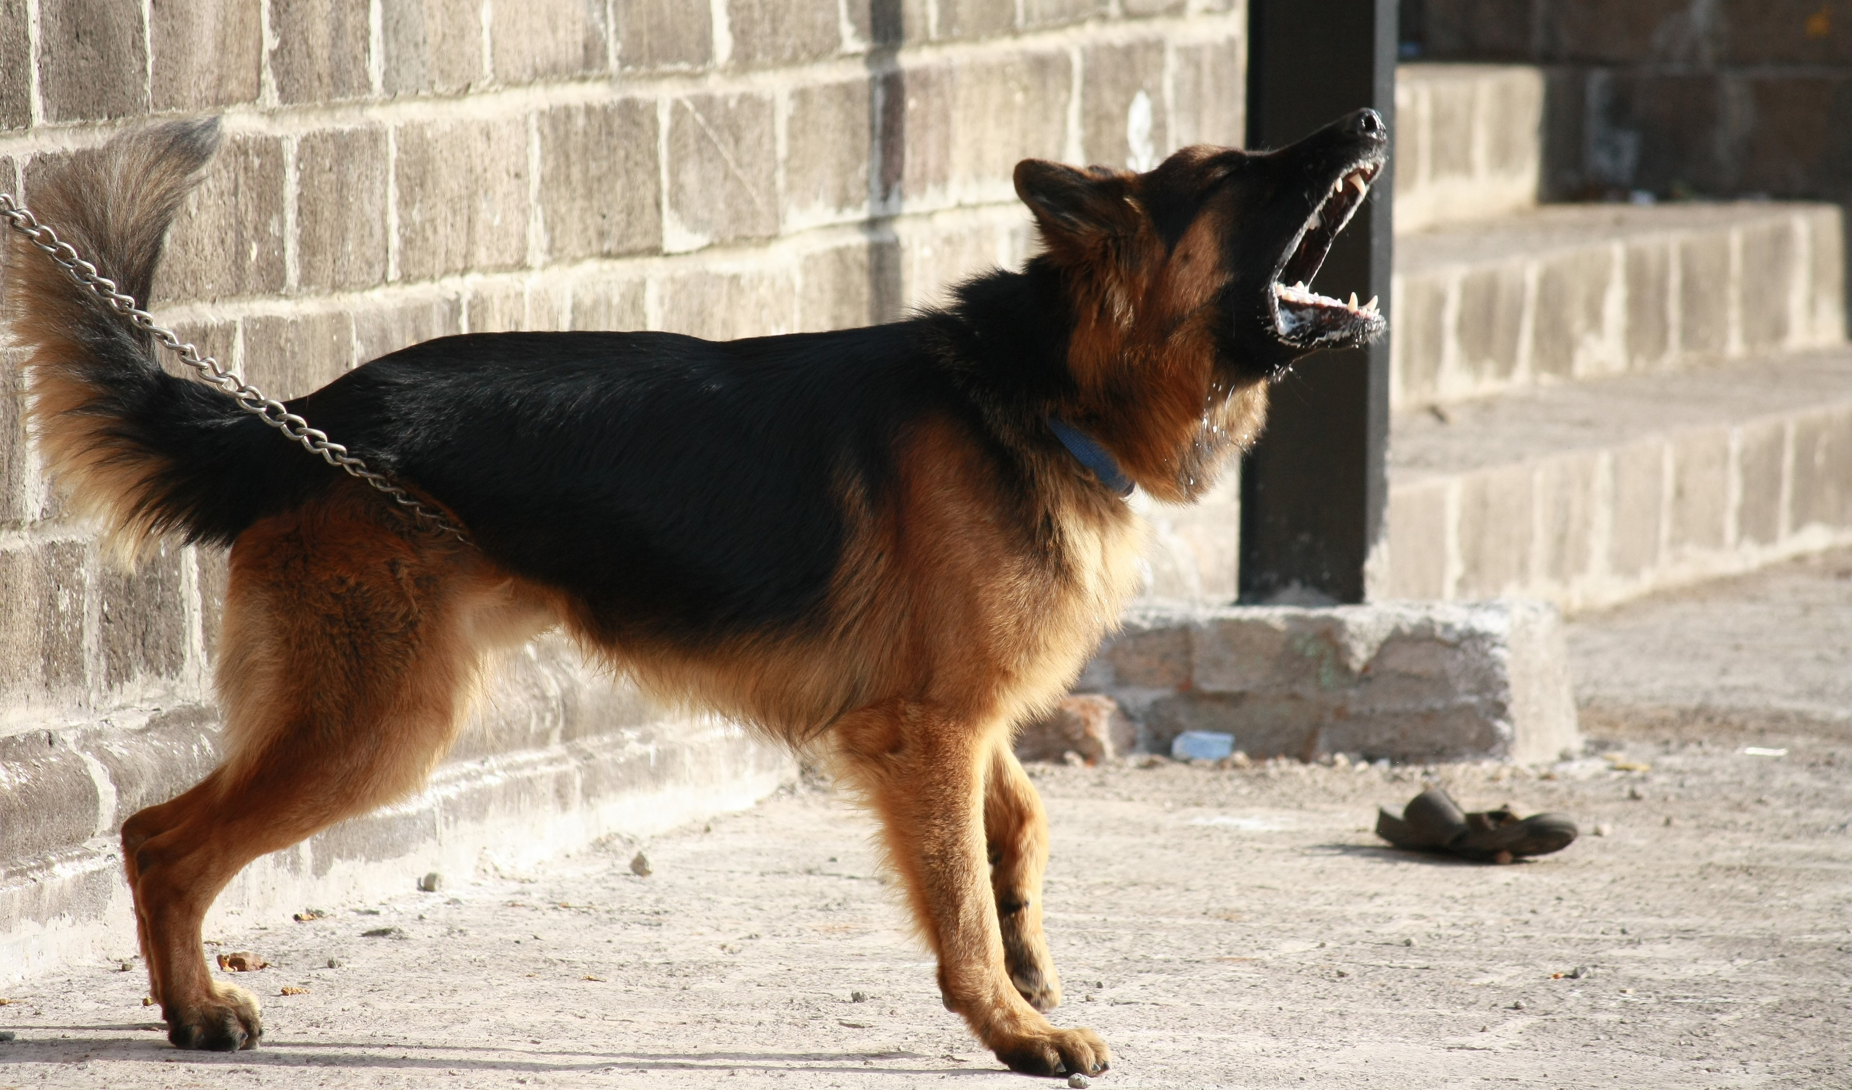
Protecting Data
CIS Control 3: Data Protection
Data discovery
DLP: Data Loss Prevention
UEBA: User Entity Behavior Analytics
Also closely connected with IAM aspects (especially UEBA).
CIS Control 11: Data Recovery
Backup and recovery strategies.
Immutable cloud storage, tape backup, and vaulting.

Slide 79

Identity and Access Management (IAM)
IAM Controls
CIS Control 5: Account Management
CIS Control 6: Access Control Management
Elements of IAM:
Provisioning of Accounts (and deprovisioning)
Authentication.
Authorization.
Involves Directory Services (AD/AAD), federation, MFA, etc.
Also, includes elements such as Conditional Access, Zero Trust, UEBA, PAM, etc.
This Photo by Unknown Author is licensed under CC BY-SA

Slide 80
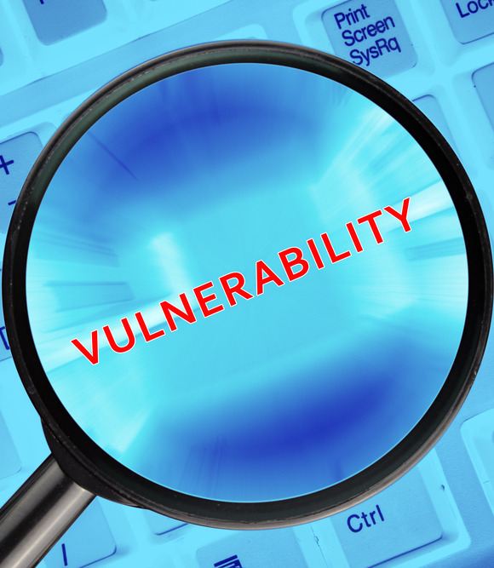
Vulnerability Management / GRC
CIS Control 7: Continuous Vulnerability Management
Network scans (detection of devices and vulnerabilities)
Agent-based scans
Detection on-the-wire (NDR or asset management feature overlap)
CIS Control 16: Application Software Security
CI/CD pipelines
Static code analysis
Web application scanning
CIS Control 18: Penetration Testing
Purple teaming, internal continuous assessment
Outside assessments
Validate malware defenses using realistic TTPs (tools, techniques, procedures)
CIS Control 15: Service Provider Management
Vendor risk assessment (OSINT, Questionnaires, Secure Integration, etc.)
This Photo by Unknown Author is licensed under CC BY-SA-NC

Slide 81

Email and Web Protections
CIS Control 9: Email and Web Browser Protections
Email gateway (reputation, link detonation, sandboxing, etc.)
Automation of response for known bad and ability for SOC to pull emails.
SPF/DKIM/DMARC
Browser Isolation
URL/DNS protection on host and/or network level
Abuse mailbox management
CIS Control 14: Security Awareness and Skills Training
Training courses (usually online, mandatory)
Awareness updates (email, intranet, etc.)
Contests and employee engagement
Phishing simulations and continuous testing

Slide 82
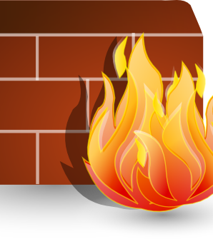
Network Defenses
CIS Control 12: Network Infrastructure Management
Edge firewalls
Networks segmentation and inspection
L7 vs L3 protections
SSL/TLS inspection
Micro-segmentation
CIS Control 13: Network Monitoring and Defense
NDR and IDS
Spanning/inspecting traffic intelligently
Closely related to Audit Log Management (8) for the purpose of Incident Response (17).
This Photo by Unknown Author is licensed under CC BY-NC

Slide 83
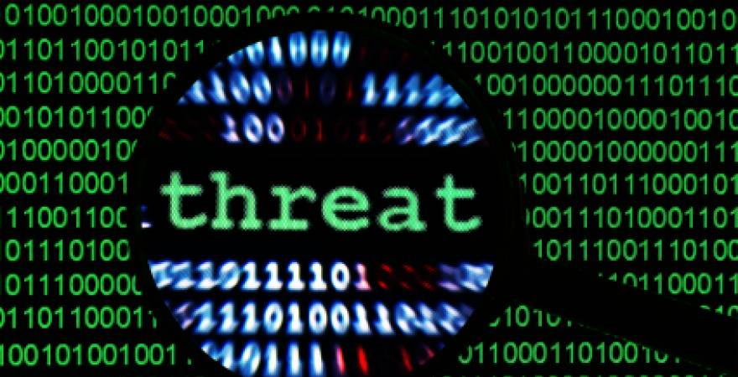
Responding to Threats
CIS Control 17: Incident Response Management
Processes:
CTI: Cyber Threat Intelligence
SOC: Security Operations Center (Triage)
Incident Response
Forensics
Tools and Technologies:
SIEM
SOAR
EDR
CIS Control 8: Audit Log Management
This is basically the data used, for the processes and tools mentioned above.
Log management, correlation and intelligence enrichment identify the work that flows into a SOC and IR process.
This Photo by Unknown Author is licensed under CC BY-SA-NC

Slide 84
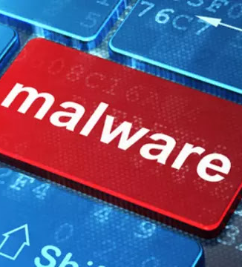
CIS Control 10: Malware Defenses
Um, what?
Wait, isn’t that all of these, really?
It is, although in this case, they mean endpoint products.
Like some other areas, what they recommend here is rather dated in some regards.
Specific Controls:
NGAV
EDR
Application Control and Script Control
Host Firewall
Host URLF
This Photo by Unknown Author is licensed under CC BY-NC

Slide 85
Threat Modeling and Risk Management

Slide 86
Fundamentals of Threat Modeling
Figure out what is important to protect (know your business)
Attacker Objectives
Identify who is a threat
Adversary Profiling
Outline the TTPs for these actors and objectives
Adversary Methods
Diagram infrastructure and associated controls
Control Mapping
Map attack flows, against infrastructure using likely TTPs.
Attack Flow Mapping
Notes:
Just thoughts according to Mike

Slide 87
Risk Management
Risk Management is where knowledge of Attack, Defense, and Response capabilities all come together to facilitate informed decision-making.
Adversary Knowledge
(CTI + ATT&CK)
Control/Posture Knowledge
(CIS18, NIST RMF + 800x)
Response Capability
(SOC / IR / Forensics)
Informed Decision-Making
Wise Investments
Sustained Improvement

Slide 88

Ways to Manage Risk
Reduce and Mitigate
Accept and Track
Transfer
This Photo by Unknown Author is licensed under CC BY-NC-ND

Slide 89
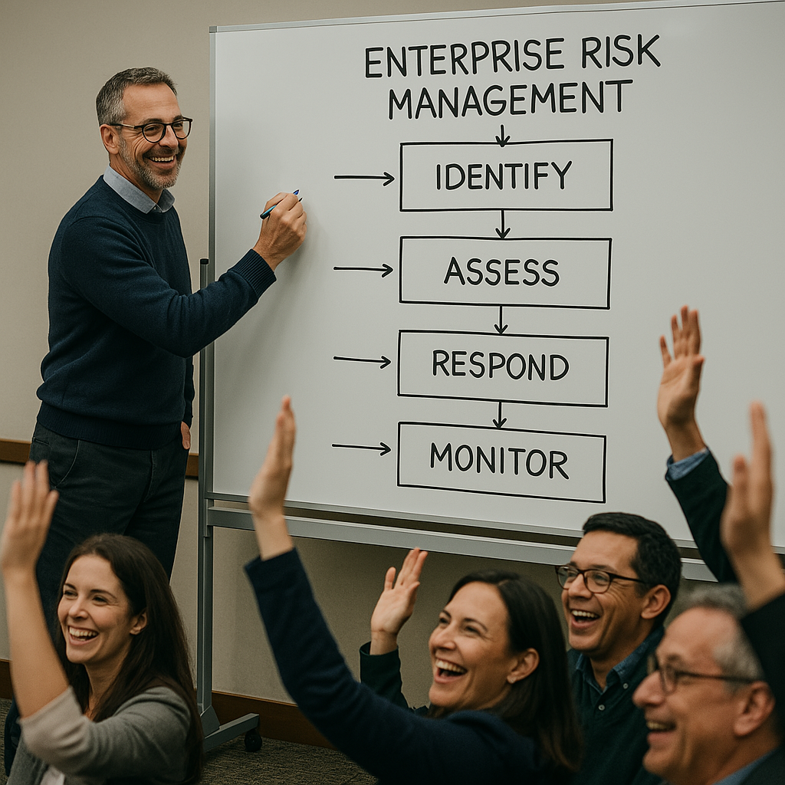
An Enterprise View of Risk
Remember that from an Enterprise Risk Management (ERM) perspective, there are different overarching categories of risk.
Key risk categories:
Business Risk (includes irrelevancy).
Technology Risk (includes security).
Financial Risk (includes lawsuits).
When we talk cyber risk, it is important for us to always remember we are not the only kind of risk an organization needs to consider.

Slide 90
Lolz

Slide 91
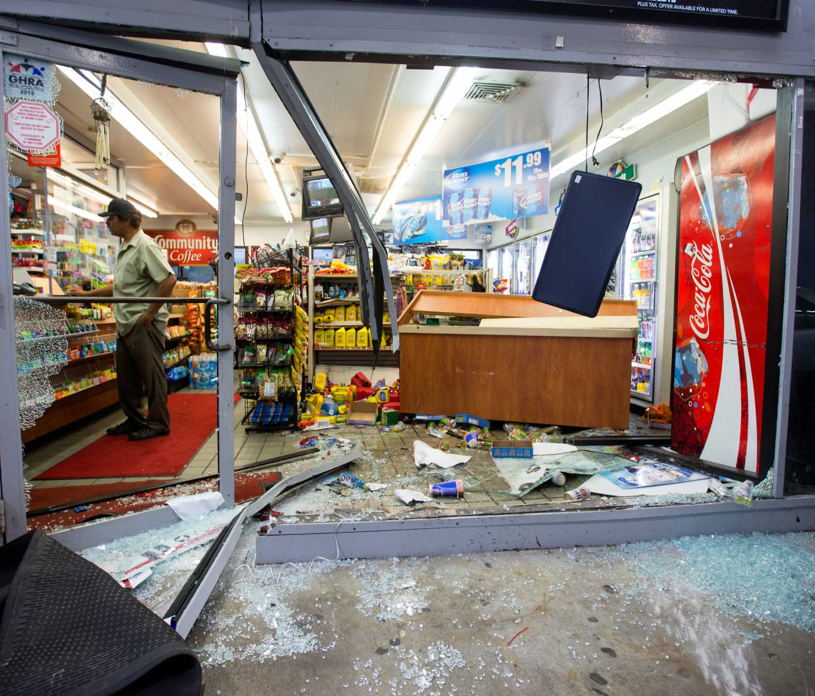
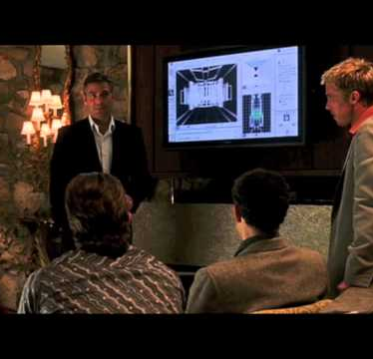
Why do Advanced Persistent Threats Utilize Living Off the Land Techniques?
The Cons of a common attack or in physical terms a “Smash and Grab Job”
Noisy
Commonly remediated by compensating controls
Harder to achieve bigger objectives on bigger institutions
Traditional remediation plans and detection logic in place to detect common attacks
Malware analysis and reverse engineering can curate Indicators of compromise that can be attributed to the adversary (Leads to preventing future attacks and event potential arrests and legal or criminal penalties.
Benefits of living off the land
Attributed to living by eating the available food on the land, adversaries and malware creators take advantage of the computer’s built-in tools and utilities as introduced at DerbyCon3 in 2013.
Utilized signed programs scripts and libraries to blend in and evade defensive controls to perform Reconnaissance, Filer operations, arbitrary code execution, lateral movement, and other compensating control bypass techniques
Hide in plain sight
Commonly attributed to privilege escalation, pivoting, and information exfiltration such as intellectual property or other personal information for monetization.

Slide 92
SOC, IR and Forensics

Slide 93

Bridge Over Incident Waters
SOC
Triage alerts, perform initial troubleshooting, analysis and escalate to IR.
IR
Respond to escalations, investigate, research, contain, and repel attacks.
Forensics
Perform deep analysis of an incident, creating a timeline of events and – where appropriate, suggest possible conclusions.
Forensics
IR
SOC
T

Slide 94
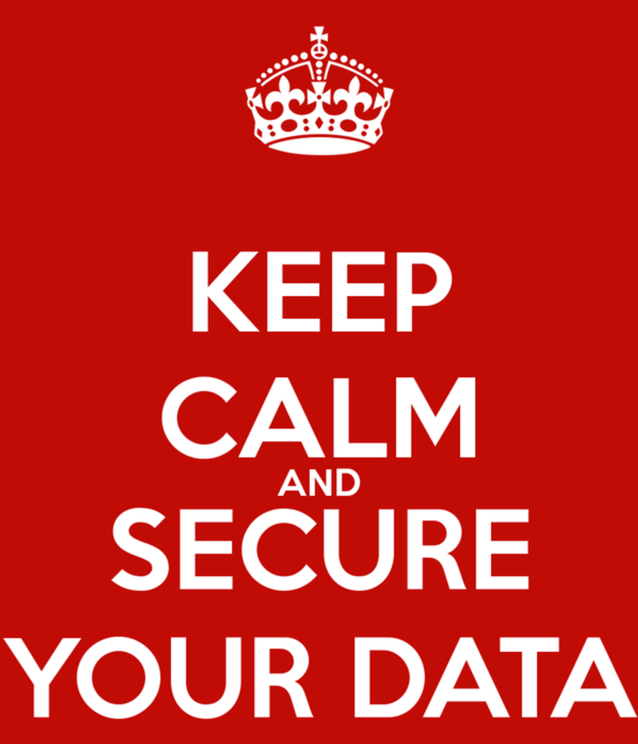
Thank you…
Any Questions?

